Slide 1

Managing Business Ethics
Chapter 1
Treviño & Nelson – 8th Edition

Slide 2

Chapter 1 Overview
Moving Beyond Cynicism
Can Business Ethics Be Taught?
This Book is About Managing Ethics in Business
Ethics and the Law
Why be Ethical? Why Bother? Who Cares?
The Importance of Trust
The Importance of Values
How This Book Is Structured

Slide 3
Moving Beyond Cynicism
Edelman Trust Barometer (2016):
  Only 49% of of consumers around the world trust institutions in general
  Globally, half of the general public and 60% of the informed public trust companies
  Business case for trust:
    91% of consumers purchase products from companies they trust
    77% of consumers refuse to purchase products from companies they don’t trust

Slide 4
MBA Oath
As a business leader, I recognize my role in society.
My purpose is to lead people and manage resources to create value that no single individual can create alone.
My decisions affect the well-being of individuals inside and outside my enterprise, today and tomorrow.
Therefore I promise:
  I will manage my enterprise with loyalty and care, and will not advance my personal interests at the expense of my enterprise or society.
  I will understand and uphold, in letter and in spirit, the laws and contracts governing my conduct and that of my enterprise.
  I will refrain from corruption, unfair competition, or business practices harmful to society.
  I will protect human rights and dignity of all people affected by my enterprise, and I will oppose discrimination and exploitation.
  I will protect the right of future generations to advance their standard of living and enjoy a healthy planet.
  I will report the performance and risks of my enterprise accurately and honestly.
  I will invest in developing myself and others, helping the management profession continue to advance and create sustainable and inclusive prosperity.
  In exercising my professional duties according to these principles, I recognize that my behavior must set an example of integrity, eliciting trust and esteem from those I serve. I will remain accountable to my peers and to society for my actions and for upholding these standards.
  This oath I make freely, and upon my honor.

Slide 5
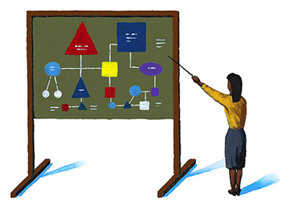
Business Ethics Defined
The principles, norms, and standards of conduct governing an individual or group

Slide 6
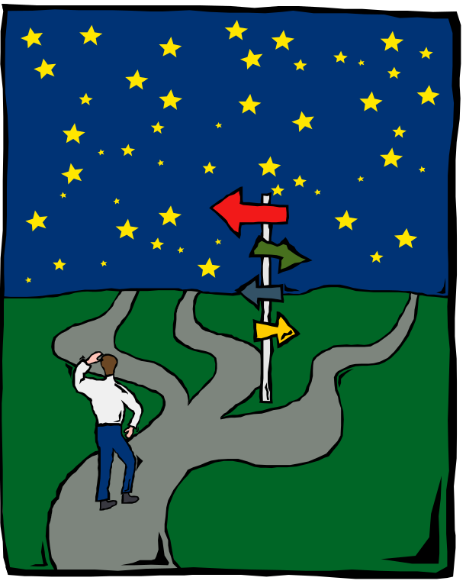
Why Bother Teaching Ethics?
Bad apples are encouraged by bad barrels
Good character isn’t always enough
Adults develop moral judgment into their 30s
Conduct is influenced by environment

Slide 7
Case
You’re the VP of a medium-sized organization that uses chemicals in its production processes. In good faith, you’ve hired a highly competent scientist to ensure that your company complies with all environmental laws and safety regulations. This individual informs you that a chemical the company now uses in some quantity is not yet on the approved Environmental Protection Agency (EPA) list. However, it has been found to be safe and is scheduled to be placed on the list in about three months. You can’t produce your product without this chemical, yet regulations say that you’re not supposed to use the chemical until it’s officially approved. Waiting for approval would require shutting down the plant for three months, putting hundreds of people out of work, and threatening the company’s very survival. What should you do?

Slide 8
CHARACTERISTICS OF INDIVIDUALS
Individual Differences
Cognitive Biases
  Process of Individual Ethical Decision-Making Behavior
MORAL
AWARENESS
ETHICAL
JUDGMENT
ETHICAL
BEHAVIOR
CHARACTERISTICS OF ORGANIZATIONS
Group and Organizational Pressures
Organizational Culture

Slide 9
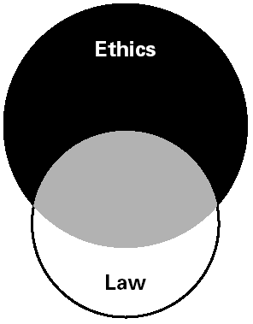
Relationship Between Ethics and the Law

Slide 10
Why Be Ethical? Who Cares?
Individuals care
Employees care
Managers care
Executives care
Industries care
Societies care

Slide 11
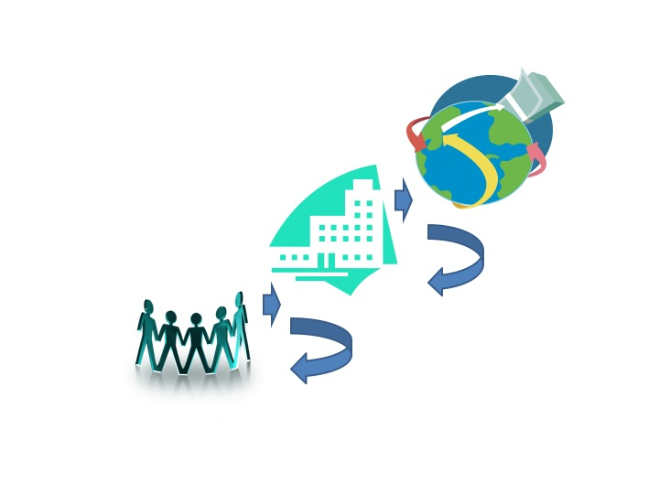
This Book Starts With Ethics and the Individual: You…
…Then it moves to: Managing Ethics in an Organization…
…then to:
Organizational Ethics & Social Responsibility

Slide 12
Test Your Cynicism Quotient
1 = Strongly Disagree 5 = Strongly Agree
Financial gain is all that counts in business.
Ethical standards must be compromised in business practice.
The more financially successful the business person, the more unethical the behavior.
Moral values are irrelevant in business.
The business world has its own rules.
Businesspeople care only about making profit.
Business is like a game one plays to win.
In business, people will do anything to further their own interest.
Competition forces business managers to resort to shady practices
The profit motive pressures managers to compromise their ethical concerns.

